Slide 1
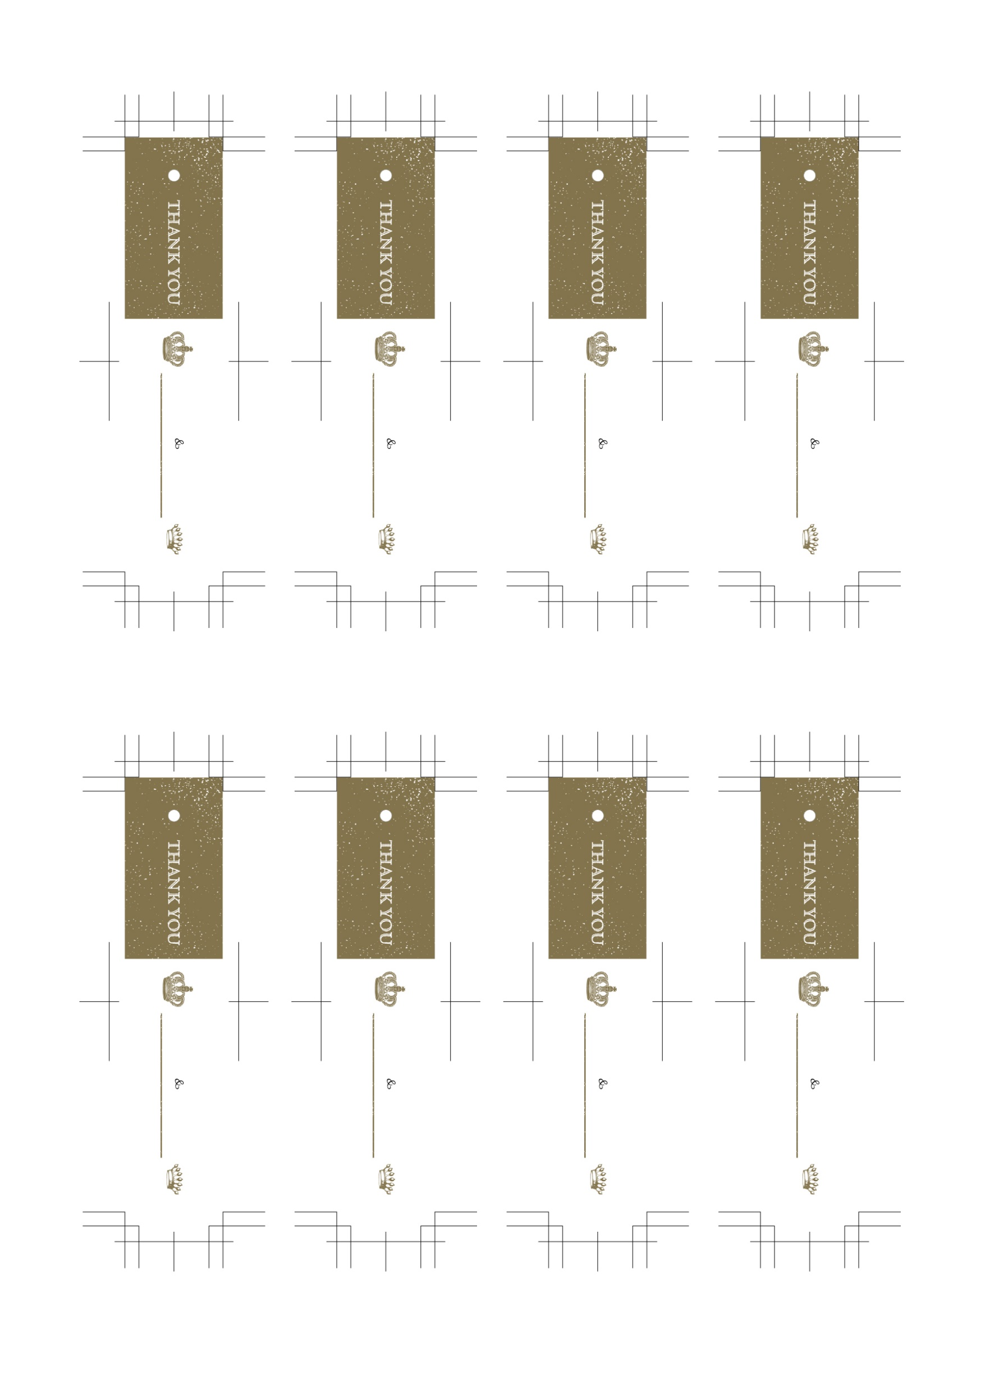
Kenta
Kenta
Kenta
Kenta
2023 / 11 / 22
2023 / 11 / 22
2023 / 11 / 22
2023 / 11 / 22
Yuri
Yuri
Yuri
Yuri
Kenta
Kenta
Kenta
Kenta
2023 / 11 / 22
2023 / 11 / 22
2023 / 11 / 22
2023 / 11 / 22
Yuri
Yuri
Yuri
Yuri

