Slide 1
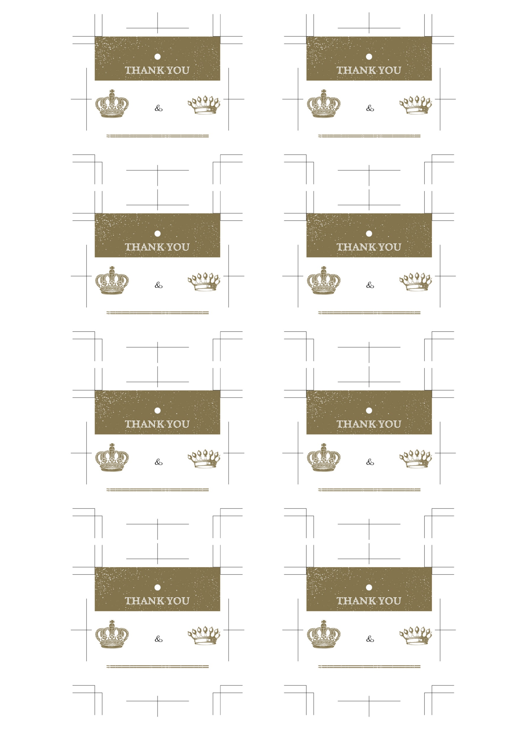
Kenta
Kenta
Yuri
Yuri
2023 / 11 / 22
2023 / 11 / 22
Kenta
Kenta
Yuri
Yuri
2023 / 11 / 22
2023 / 11 / 22
Kenta
Kenta
Yuri
Yuri
2023 / 11 / 22
2023 / 11 / 22
Kenta
Kenta
Yuri
Yuri
2023 / 11 / 22
2023 / 11 / 22

