Slide 1
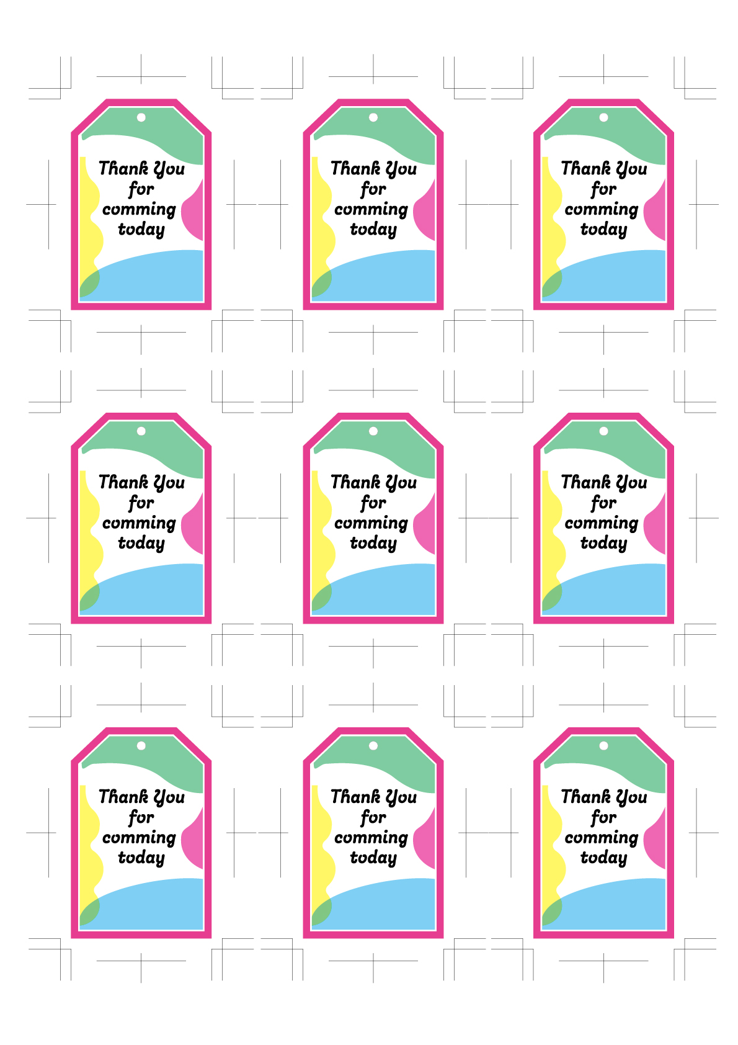
Kenta & Yuri
Dec.31.2023
Kenta & Yuri
Dec.31.2023
Kenta & Yuri
Dec.31.2023
Kenta & Yuri
Dec.31.2023
Kenta & Yuri
Dec.31.2023
Kenta & Yuri
Dec.31.2023
Kenta & Yuri
Dec.31.2023
Kenta & Yuri
Dec.31.2023
Kenta & Yuri
Dec.31.2023

