Slide 1
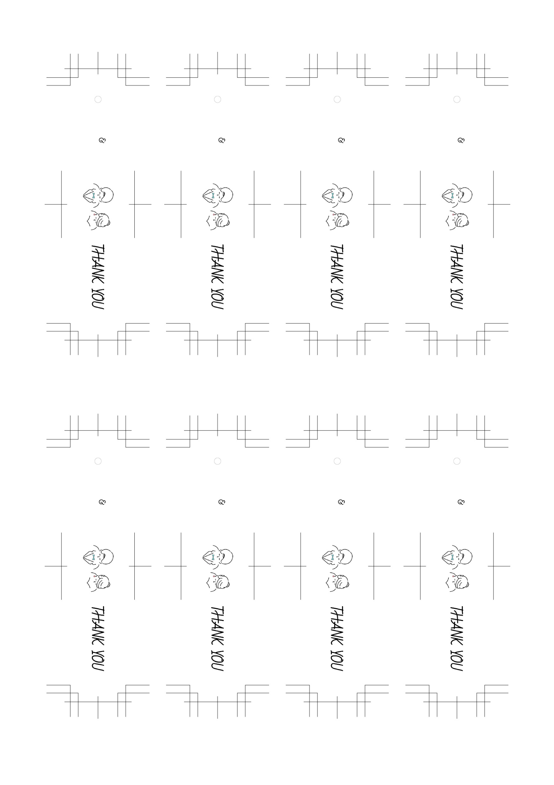
Kenta
Kenta
Kenta
Kenta
Nov / 22 / 2023
Nov / 22 / 2023
Nov / 22 / 2023
Nov / 22 / 2023
Yuri
Yuri
Yuri
Yuri
Kenta
Kenta
Kenta
Kenta
Nov / 22 / 2023
Nov / 22 / 2023
Nov / 22 / 2023
Nov / 22 / 2023
Yuri
Yuri
Yuri
Yuri

