Slide 1
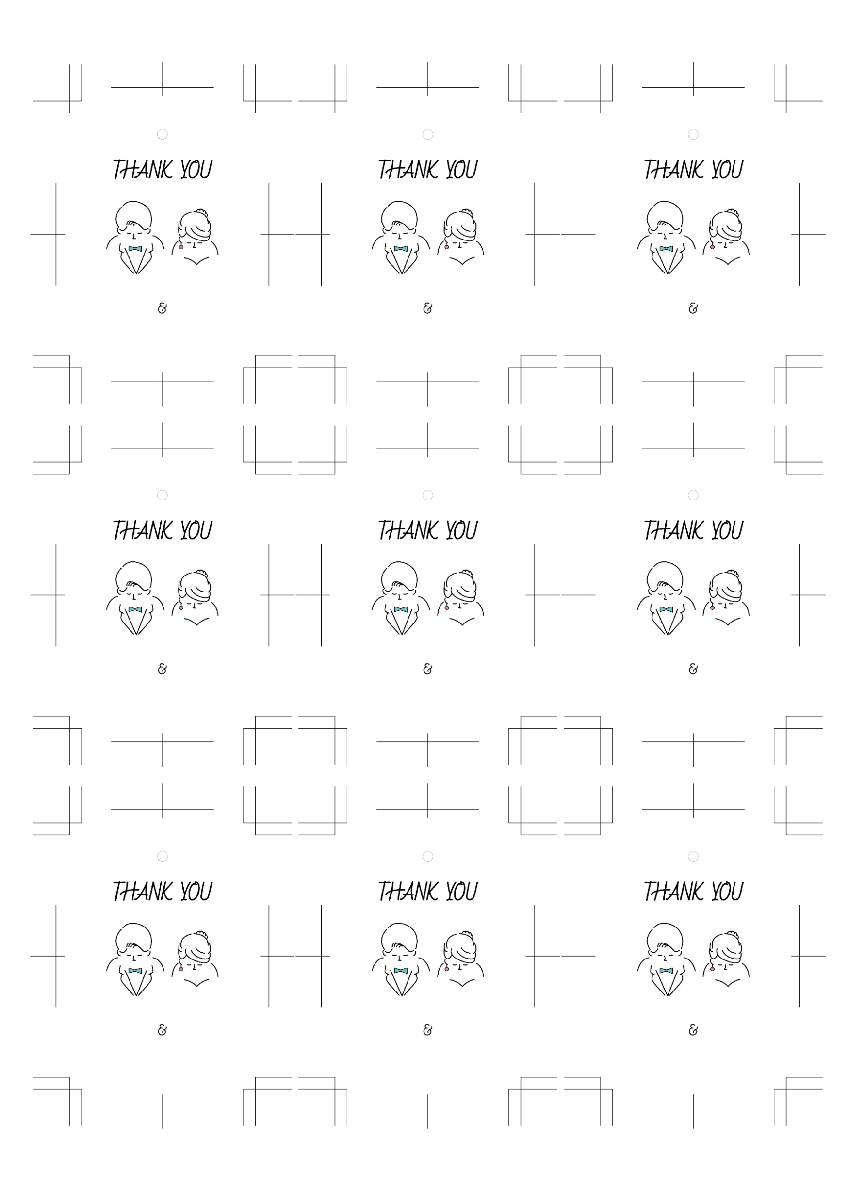
Kenta
Yuri
Kenta
Yuri
Kenta
Yuri
Nov / 22 / 2023
Nov / 22 / 2023
Nov / 22 / 2023
Kenta
Yuri
Kenta
Yuri
Kenta
Yuri
Nov / 22 / 2023
Nov / 22 / 2023
Nov / 22 / 2023
Kenta
Yuri
Kenta
Yuri
Kenta
Yuri
Nov / 22 / 2023
Nov / 22 / 2023
Nov / 22 / 2023

