Slide 1
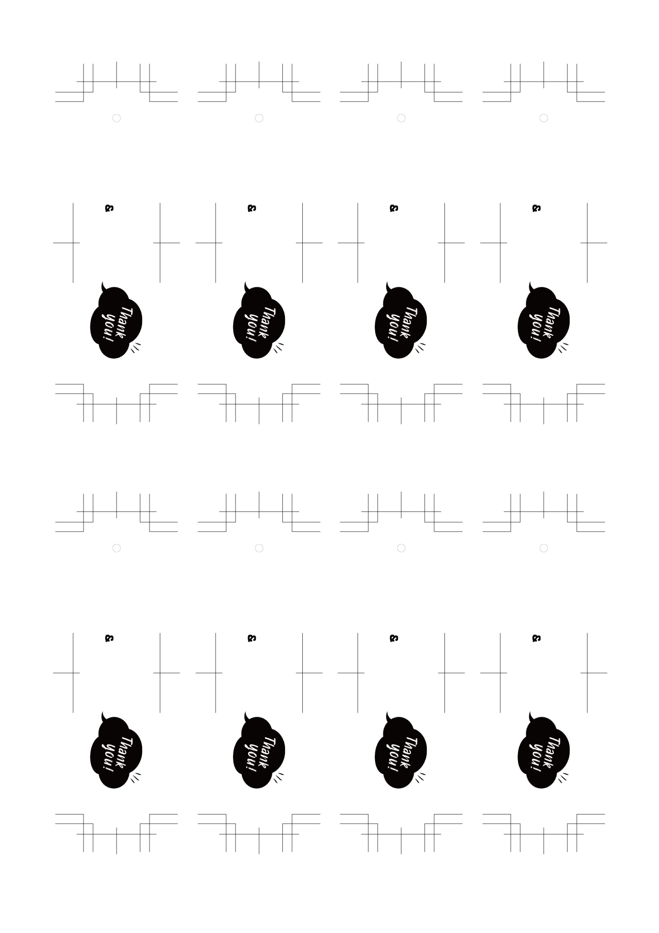
Kenta
Kenta
Kenta
Kenta
Nov,22,2023
Nov,22,2023
Nov,22,2023
Nov,22,2023
Yuri
Yuri
Yuri
Yuri
Kenta
Kenta
Kenta
Kenta
Nov,22,2023
Nov,22,2023
Nov,22,2023
Nov,22,2023
Yuri
Yuri
Yuri
Yuri

