Slide 1
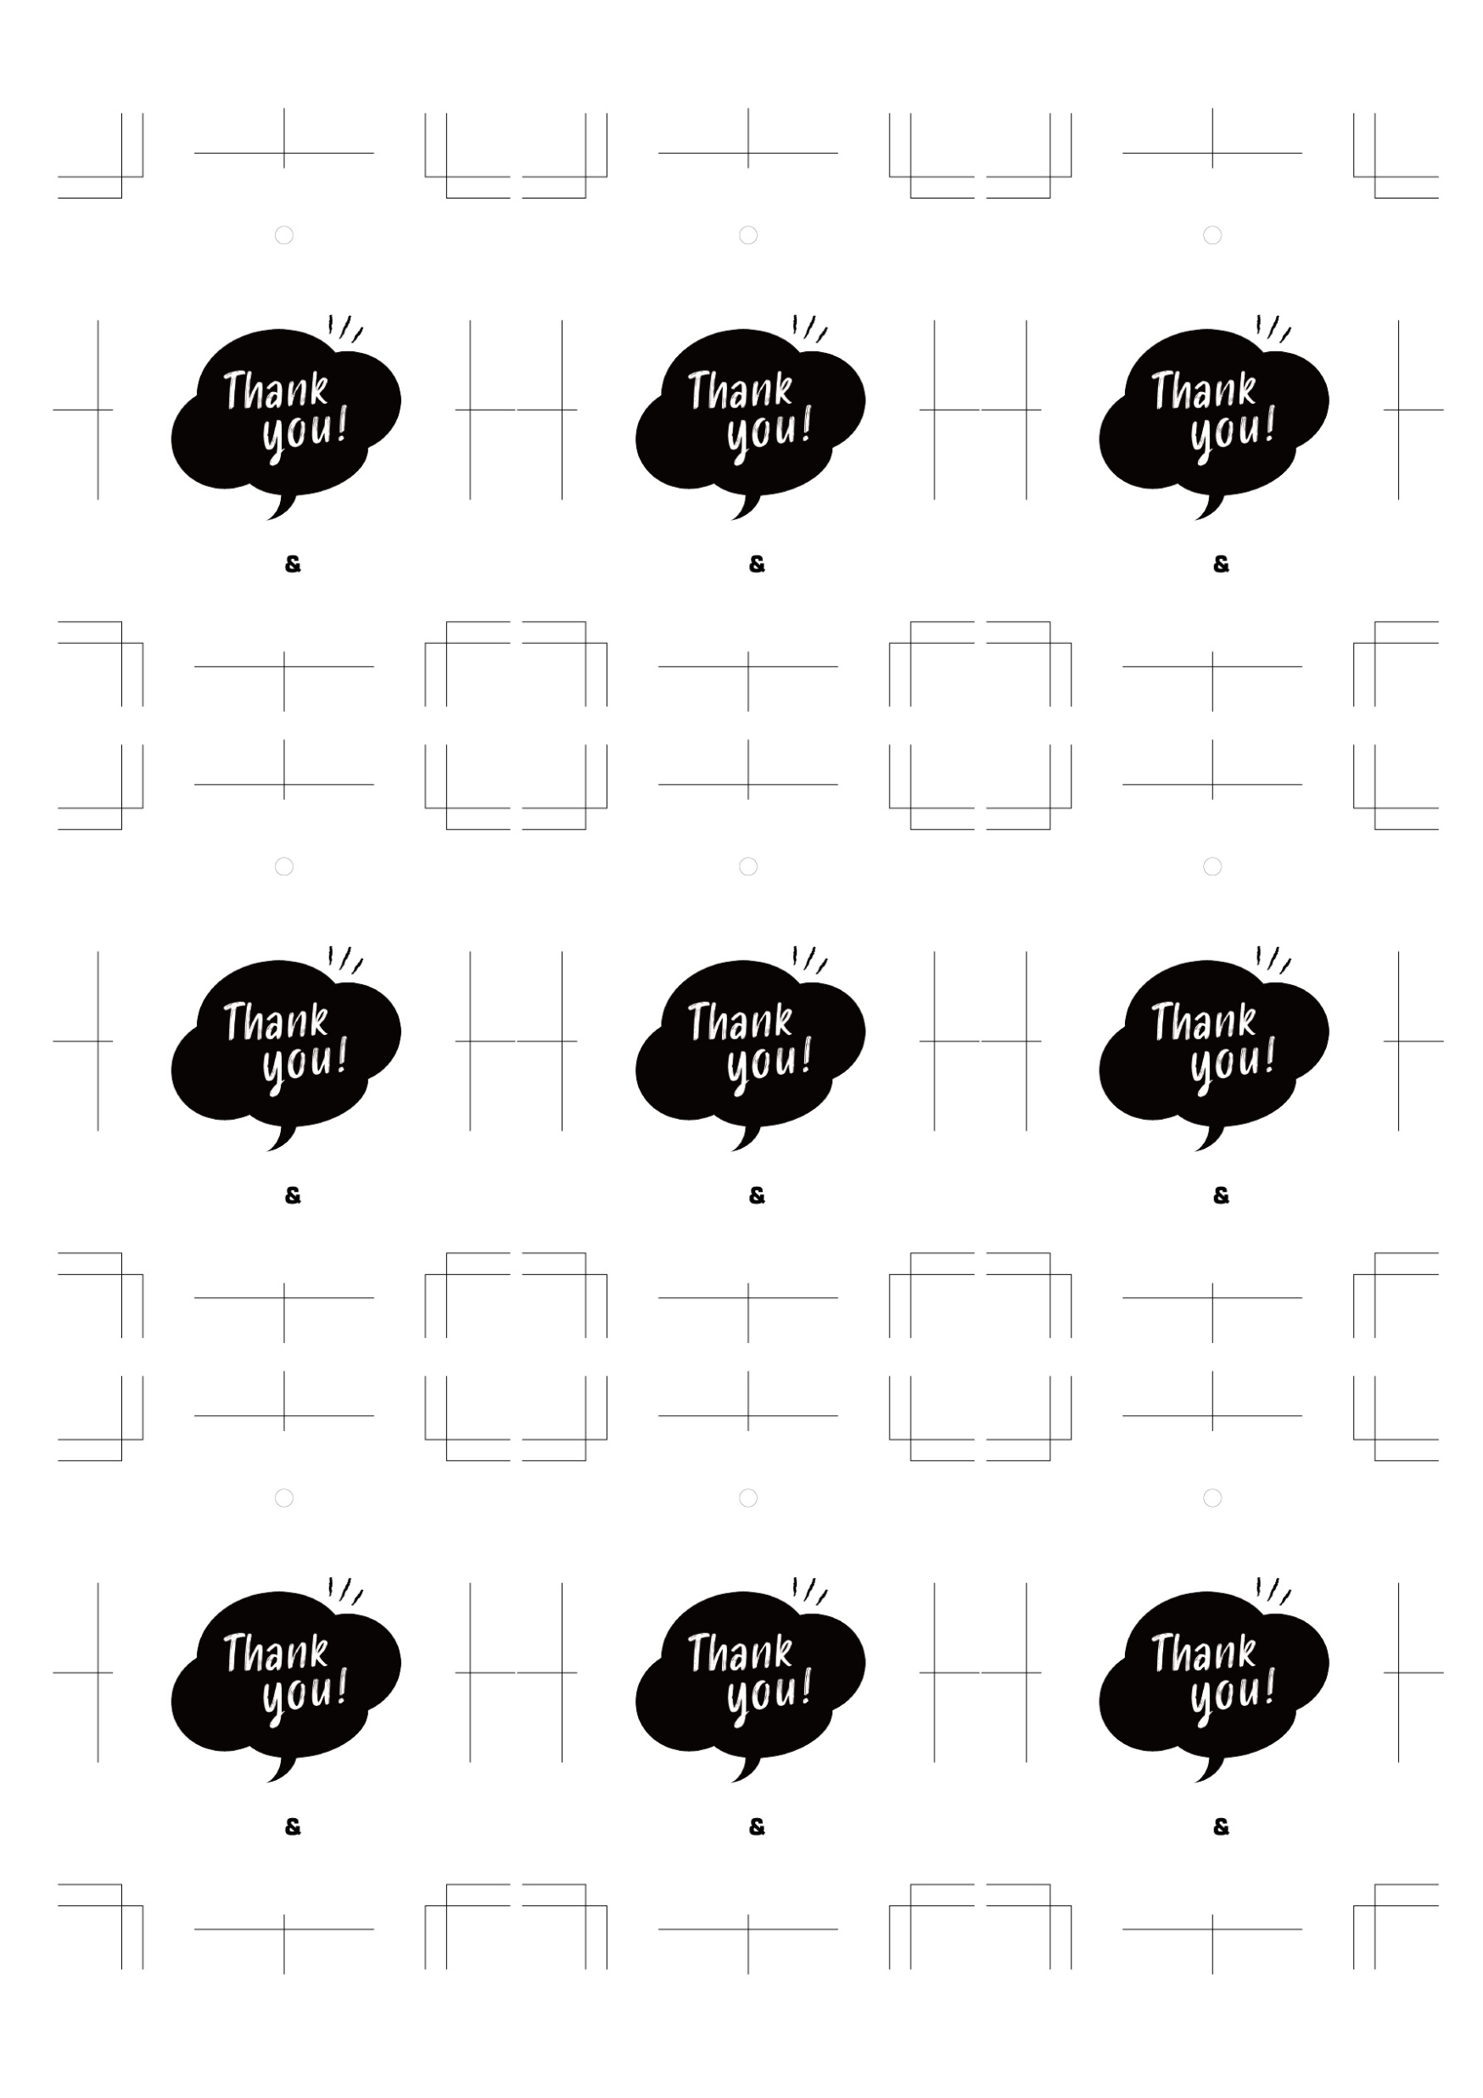
Nov,22,2023
Nov,22,2023
Nov,22,2023
Kenta
Yuri
Kenta
Yuri
Kenta
Yuri
Nov,22,2023
Nov,22,2023
Nov,22,2023
Kenta
Yuri
Kenta
Yuri
Kenta
Yuri
Nov,22,2023
Nov,22,2023
Nov,22,2023
Kenta
Yuri
Kenta
Yuri
Kenta
Yuri

