Slide 1
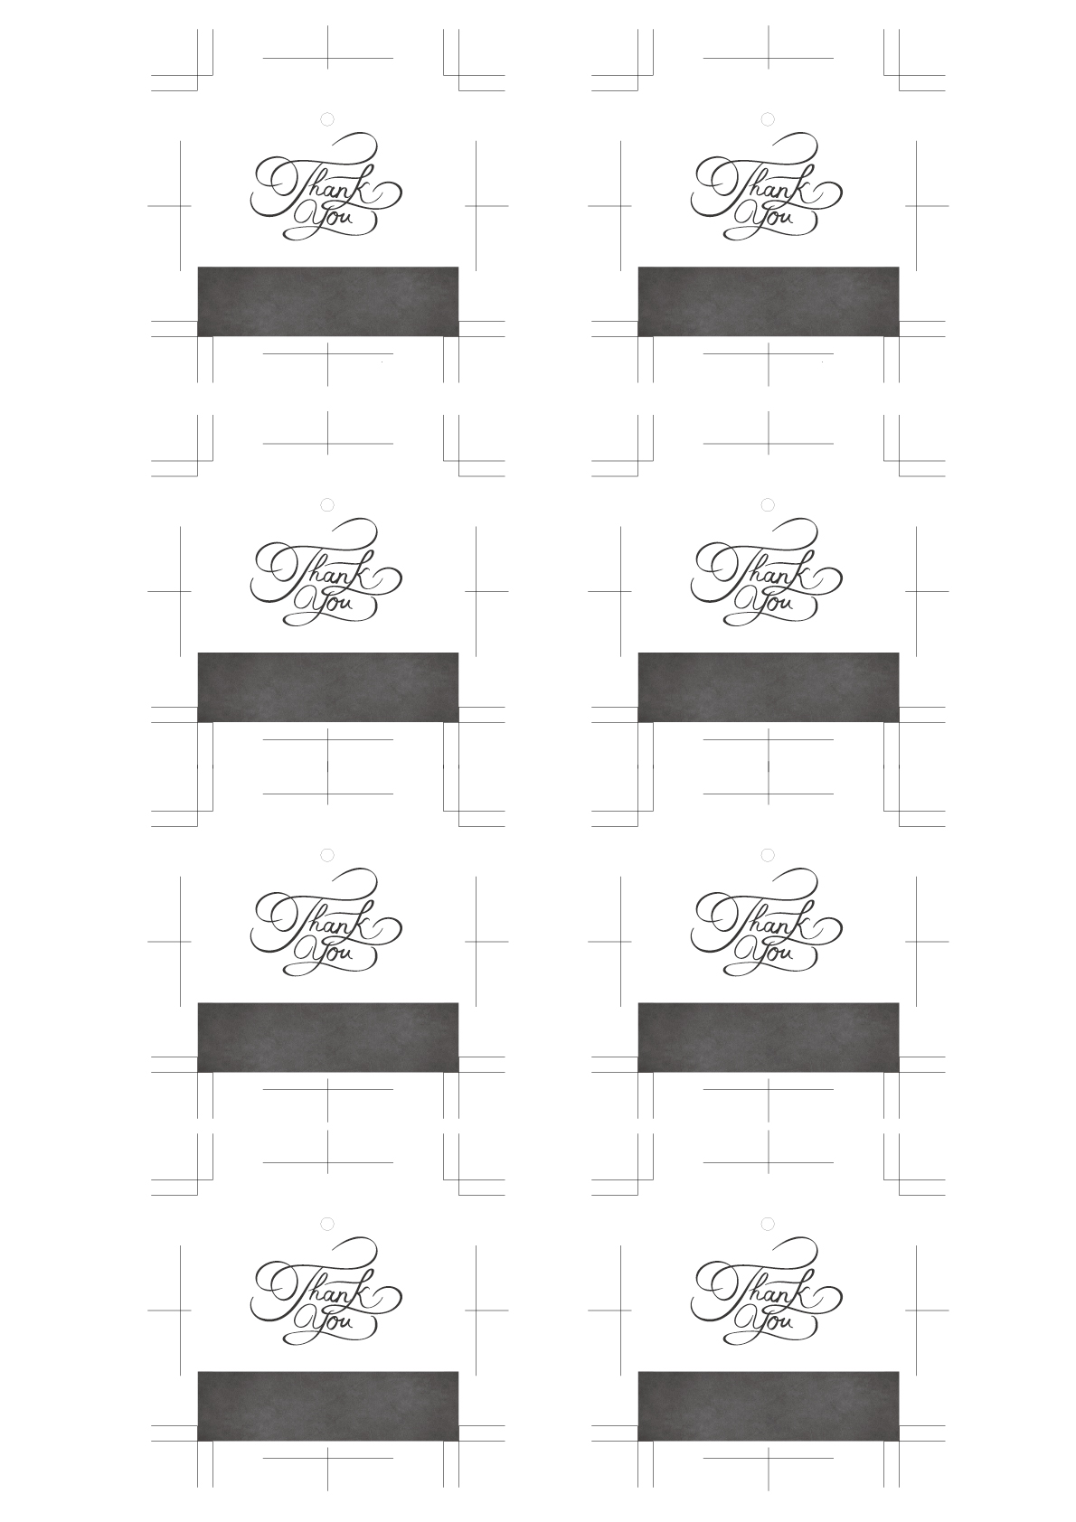
Kenta & Yuri
Kenta & Yuri
Kenta & Yuri
Kenta & Yuri
Kenta & Yuri
Kenta & Yuri
Kenta & Yuri
Kenta & Yuri

