Slide 1
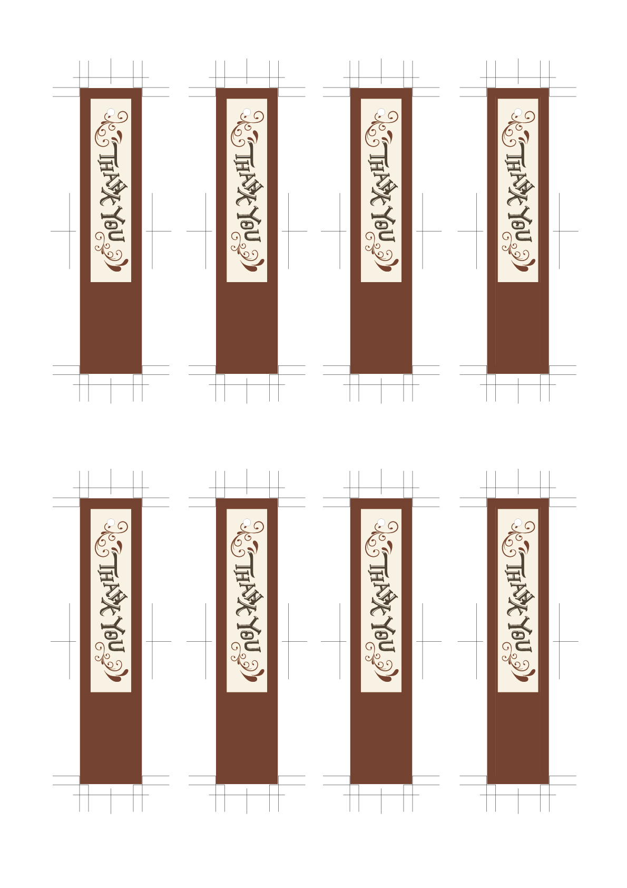
Kenya & Yuri
Dec.31.2023
Kenya & Yuri
Dec.31.2023
Kenya & Yuri
Dec.31.2023
Kenya & Yuri
Dec.31.2023
Kenya & Yuri
Dec.31.2023
Kenya & Yuri
Dec.31.2023
Kenya & Yuri
Dec.31.2023
Kenya & Yuri
Dec.31.2023

